Slide 1
Understanding Unit Testing
INTRODUCTION TO AUTOMATED TESTING AND UNIT TESTING

Slide 2

Introduction
Ikhwan Hayat (a.k.a 1kHz)
9 years experience developing software
Freelance Software Developer
ikhwanhayat@gmail.com

Slide 3
manual
Testing?
acceptance test
VS
automated
integration test
unit test
white box
VS
black box

Slide 4

Unit?
Unit testing is a method by which individual units of source code are tested to determine if they are fit for use.
One can view a unit as the smallest testable part of an application.
Unit tests are created by programmers or occasionally by white box testers during the development process.
Notes:
In procedural -> module/function, In OOP -> class/method. Jenis test paling mendalam. What you actually test is behavior.

Slide 5
TDD
Test Driven Design
It’s NOT testing, but using tests to DRIVE the design
As a side-effect, you got unit tests! With good level of coverage!

Slide 6
RED
Write a failing test. With empty class/method.
GREEN
Fill in the class/method implementation. Make the tests pass.
REFACTOR
Make code better.

Slide 7
Demo: Bank Account
Requirements
Can create bank accounts
Can deposit money into account
Can withdraw money from account
Throw exception if balance is insufficient
Can transfer money from one account to another
Can insert and update accounts into database

Slide 8
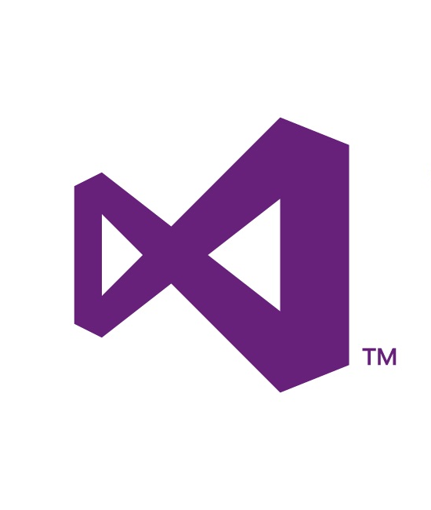


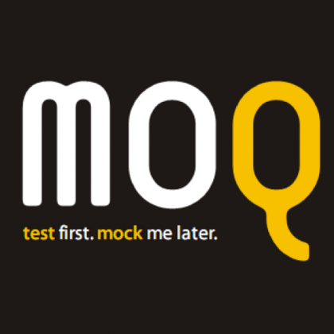
Tools
IDE / Platform
http://www.microsoft.com/visualstudio/eng/products/visual-studio-express-for-web
Unit Testing Framework
http://nunit.org/
Mocking Framework
https://code.google.com/p/moq/
Notes:
Create projects

Slide 9
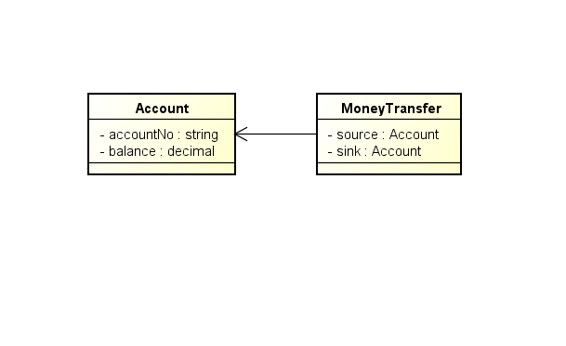
Design
Notes:
Go to codes

Slide 10
ARRANGE
ACT
ASSERT

Slide 11
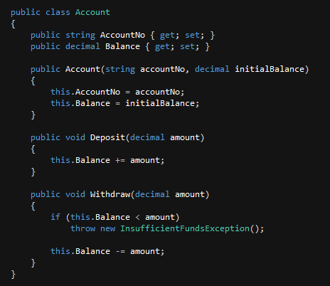
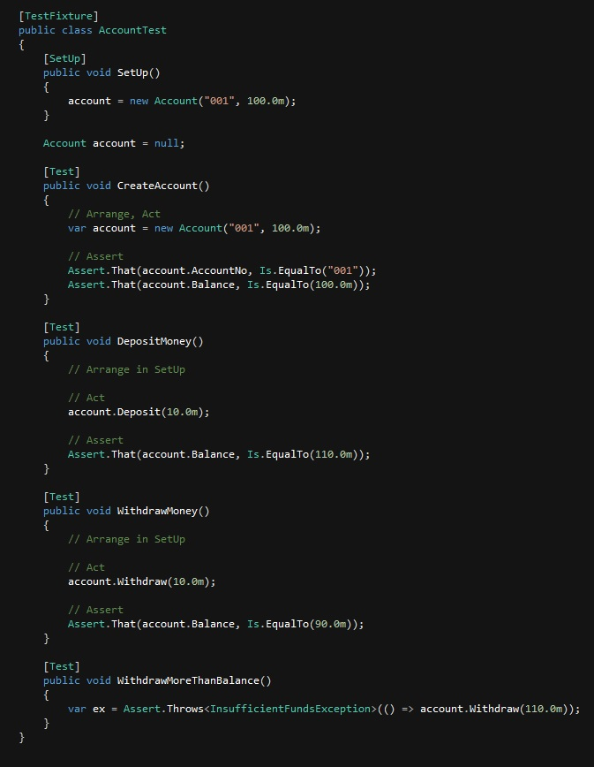
Unit
Test

Slide 12
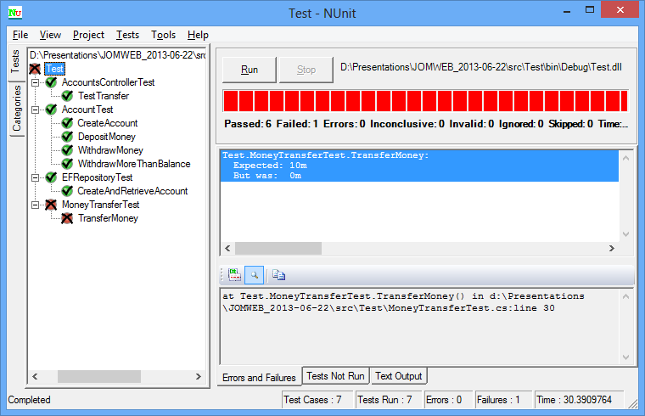

Slide 13
Design 2
Notes:
Go to codes

Slide 14
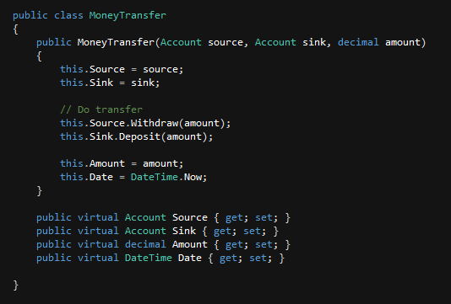
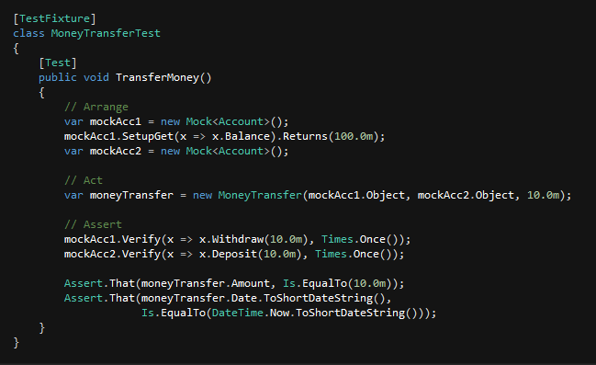
Unit
Test

Slide 15
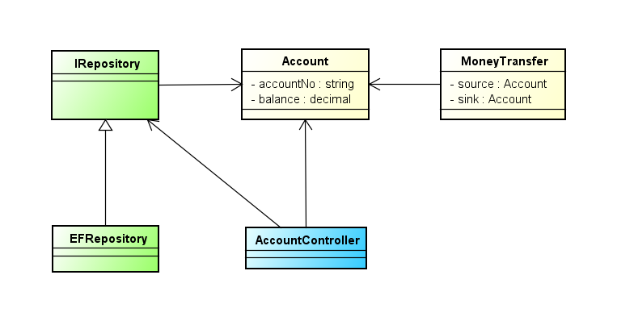
Design 3
Notes:
Copy files

Slide 16
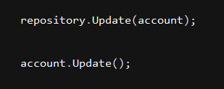
repository
VS
active record
???

Slide 17
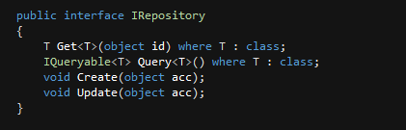
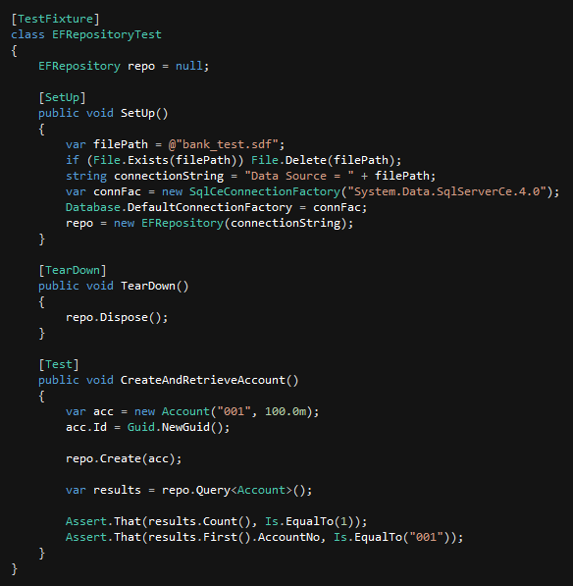
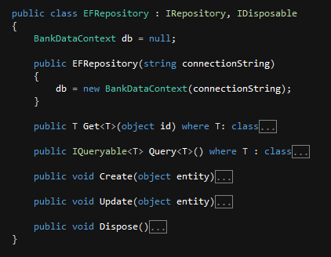
Unit
Test

Slide 18
A good unit test is…
Isolated/independent
Test one thing at a time.
Unit under test doesn’t depend on the other to make test runs.
Repeatable
Running multiple times yields the same result.
Doesn’t rely on environment.
Fast
You want to repeat it again and again.
You want it to be a pleasure to work with.
Self-Documenting
Test code and code under test clear and concise.
Can be a reference for usage of your class/method/etc.

Slide 19
Dependency Injection
Single Responsibility Principal
Separation of Interface and Implementation

Slide 20
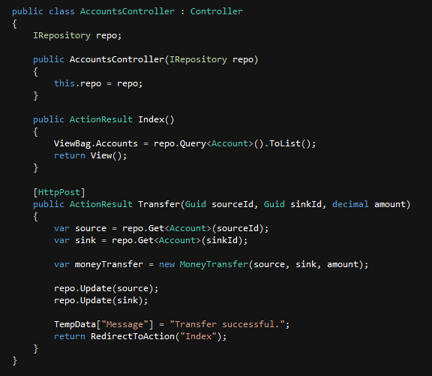
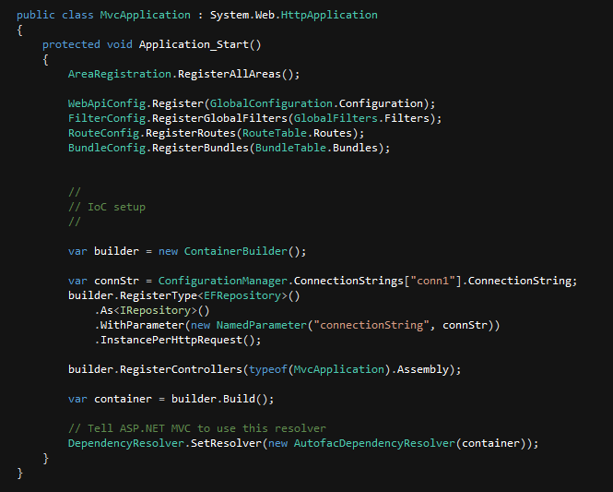
Web Controller
DI/IoC Setup

Slide 21
“Mocking” allow us to isolate dependent units.

Slide 22
Types of Test Doubles
Dummy objects are passed around but never actually used. Usually they are just used to fill parameter lists.
Fake objects actually have working implementations, but usually take some shortcut which makes them not suitable for production.
Stub objects provide canned answers to calls made during the test, usually not responding at all to anything outside what's programmed in for the test.
Mock objects are pre-programmed with expectations which form a specification of the calls they are expected to receive.

Slide 23
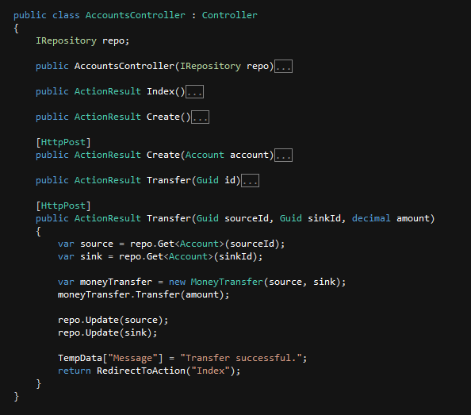
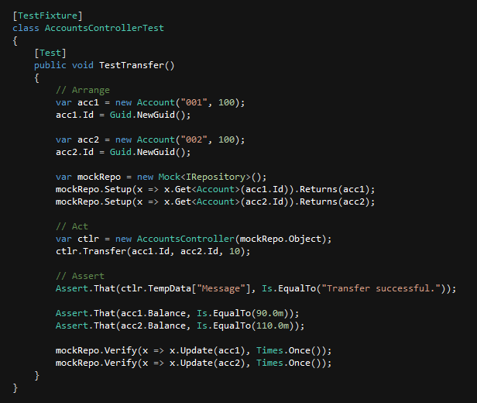
Unit
Test

Slide 24
Benefits
Instant feedback
Write test, write code, see instant result.
Promote modularity in your design
DI, SRP, Interface vs Implementation.
Safety net
Change/add code and check if business rules are still honored.
Free documentation
Can be a reference for usage of your class/method/etc.

Slide 25
Done!
We have learned…
What is unit testing.
TDD.
How to write good unit tests.
How unit testing can benefit us.
Get the codes and slides at…
https://github.com/ikhwanhayat/jomweb_unittest

Slide 26
Next?
You can go on with…
Learning BDD (Behavior Driven Design).
Research CI (Continuous Integration).
Learn on how to design testable systems.
Use unit testing for your project! (I mean, seriously, USE IT!)

Slide 27
MOAR!
Google+ MyDev
http://www.mydev.my/automated-testing-dalam-pembangunan-perisian.html
ikhwanhayat@gmail.com
THANK YOU FOR LISTENING!

